Slide 1
Loan prediction based on customer bEHAVIOUR
Project - 9

Slide 2
BUSINESS Problem STATEMENT
Lending institutions face a significant challenge in accurately assessing the creditworthiness of loan applicants. This challenge arises from the complex interplay of various customer behavior patterns that influence their ability to repay loans. Inaccurate assessments lead to an increased risk of loan defaults, which can cause substantial financial losses for the institution.

Slide 3
OBJECTIVE
Develop and implement a robust loan prediction model that accurately identifies potential defaulters based on customer behavior. The model aims to achieve the following specific goals:
Risk Identification and Mitigation
Precision in Decision-Making
Adaptability and Robustness
Empower Informed Decisions
Minimize Defaults

Slide 4





SOLUTION APPROACH
DATA COLLECTION
DATA
preprocessing
DATA VISUALISATION
MODEL IMPLEMENTATION
MODEL DEPLOYMENT
Data was provided by a finance company through Kaggle.
Deal with missing values, inconsistencies, outliers and also apply data wrangling techniques
Understand and get insights into data through visualization charts and graphs using Auto EDA and Tableau
Implement various possible machine learning algorithms and evaluate them.
Choose the best model from model’s evaluation and deploy it using Flask

Slide 5








MEET OUR TEAM
PATTAN SHEKSHAVALI
NELLORE SAI NIKHIL
G CHAITANYA SAI​
M pranai kumar reddy
21BCE7912
21BCE8845
21BCE8060
21BCE7264

Slide 6
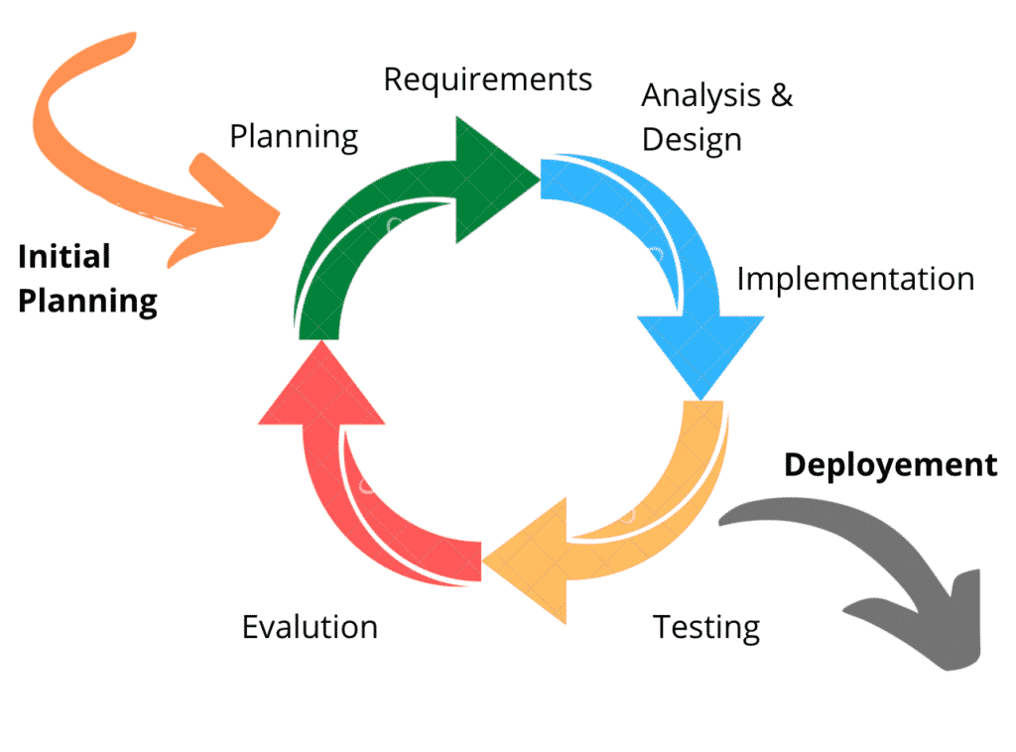
AGILE METHODOLOGY

Slide 7
TIMELINE
2nd NOV 2023
4th NOV 2023
6TH NOV 2023
7TH NOV 2023
8TH NOV 2023
DATA
COLLECTION
DATA PREPROCESSING
DATA VISUALIZATION
DATA
WRANGLING
MODEL IMPLEMENTATION

Slide 8
TIMELINE
9TH NOV 2023
10TH NOV 2023
12TH NOV 2023
13TH NOV 2023
14TH NOV 2023
MODEL IMPROVISATION
MODEL
EVALUATION
DOCUMENTATION
MODEL DEPLOYMENT
REPORTING

Slide 9
DATA UNDERSATNDING
The dataset for this project was obtained from Kaggle, a popular platform for data sharing and machine learning competitions.
13 columns and 25200 rows.
No missing values.
7 numerical features.
6 categorical features.

Slide 10
DATA PREPROCESSING
DATA CLEANING - This involves identifying and correcting errors, inconsistencies, and missing values in the data. Techniques like imputation, outlier removal, and error correction are employed to ensure data integrity.
LABEL ENCODING - To handle the categorical data, we employed label encoding, a technique that transforms categorical values into numerical representations.
STANDARD SCALING - Subsequently, we applied the Standard Scaler technique to standardize the numerical data, ensuring consistency in the scale of the features.
SMOTE - To address the imbalanced class distribution, we utilized the SMOTE (Synthetic Minority Oversampling Technique) algorithm

Slide 11
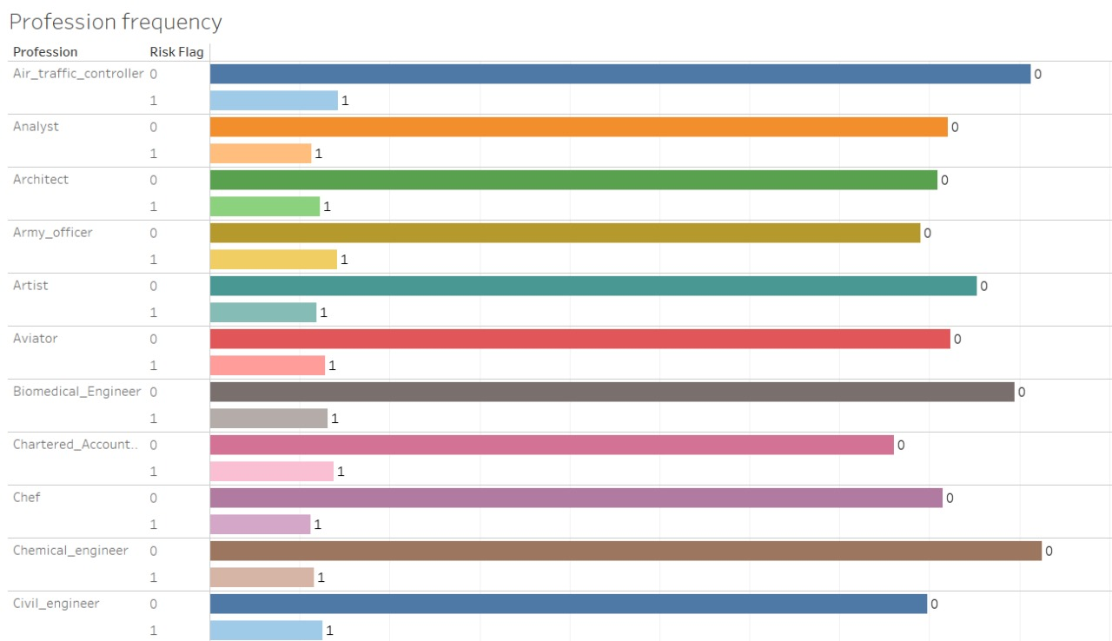
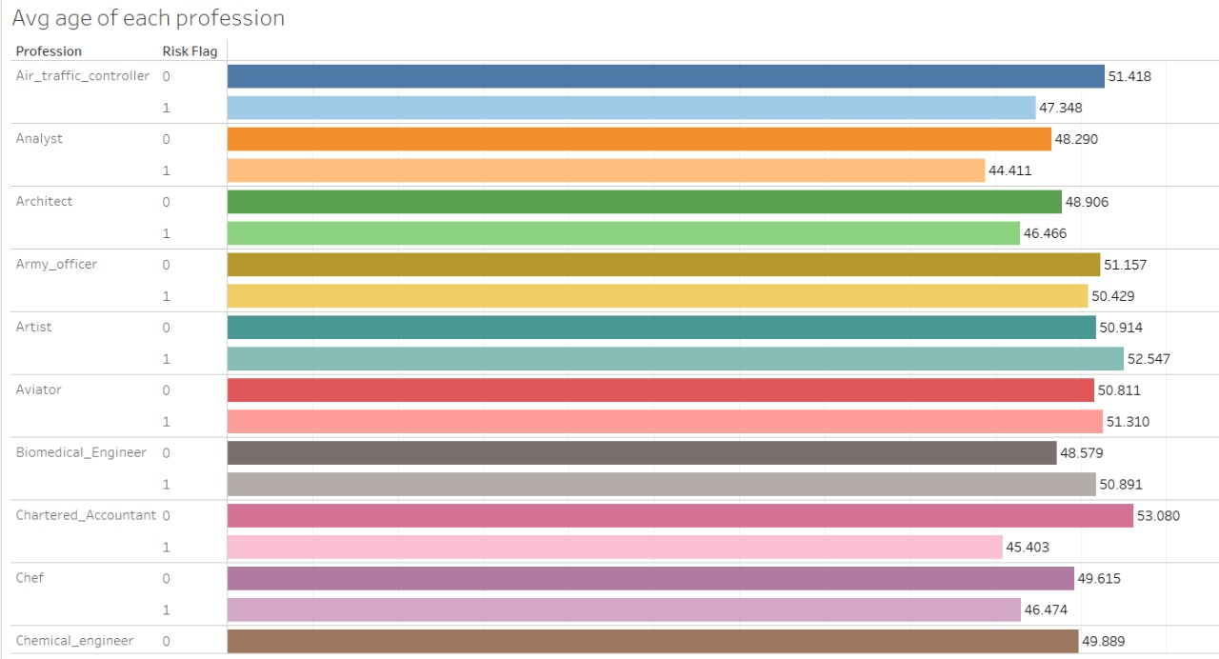
DATA VISUALIZATION

Slide 12
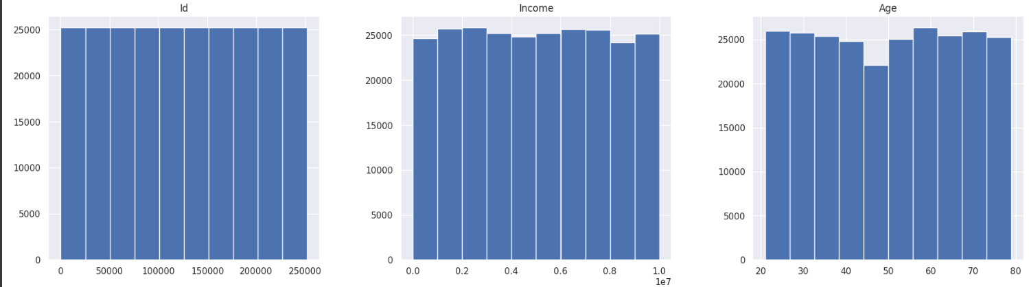
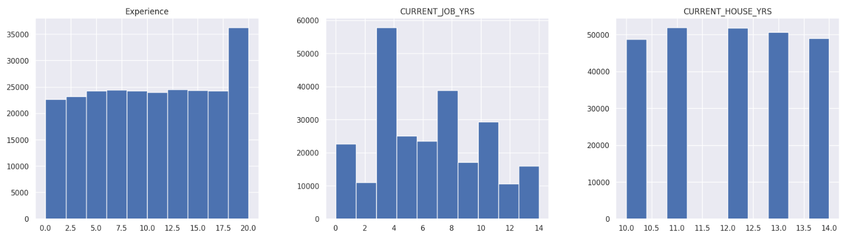
DATA VISUALIZATION

Slide 13
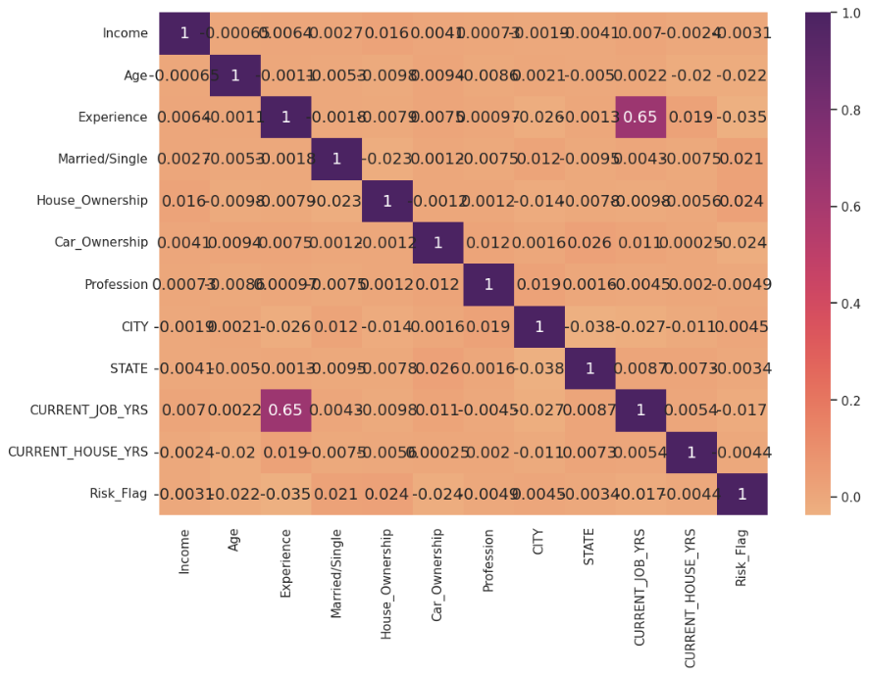
DATA VISUALIZATION

Slide 14
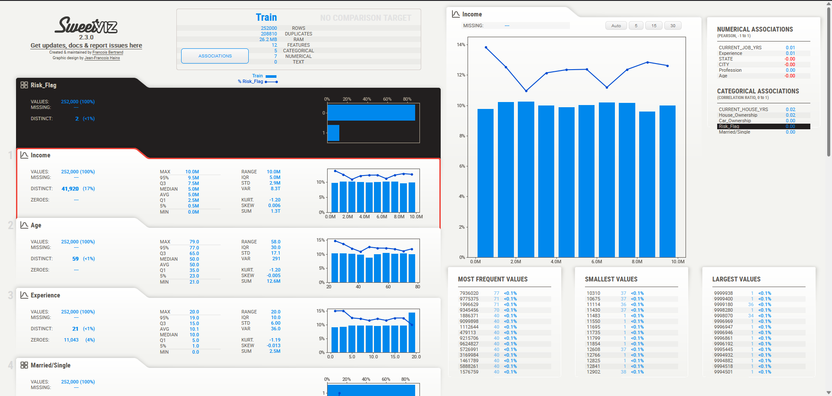
DATA VISUALIZATION

Slide 15
MODEL IMPLEMENTATION
In tackling the classification problem presented, we have leveraged the power of supervised and ensemble machine learning techniques. Our exploration of various algorithms has encompassed the following models :
Logistic Regression.
Decision Tree Classifier.
Random Forest Classifier.
Extra Trees Classifier.
Adaptive Boosting (AdaBoost Classifier).
AdaBoost Classifier with Decision Trees as base Estimator.
Gradient Boosting Classifier.
Extreme Gradient Boosting Classifier (XGBClassifier).
Light Gradient Boosting Classifier (LGBMClassifier).
Cat Boost Classifier.

Slide 16
MODEL EVALUATION AND DEPLOYMENT
Accuracy, precision, recall, F-score, and AUC score were employed as the evaluation metrics. These metrics provide a comprehensive assessment of the models' ability to correctly classify the data.
EXTRA TREES CLASSIFIER came out to be the most suitable machine learning model.
HTML AND FLASK for Deployment.

Slide 17
THANK YOU

